Slide 1
Advertisement Click Prediction
Assignment : Machine Learning
Student : Jagadish Janakiraman
Date : 05/23/2022

Slide 2
Click Predictions
Based on the Data Analysis, most of the advertisement clicks are originated from
Peak Days – Monday, Tuesday and Wednesday
Peak Hours - 8 AM to 5 PM
Banner Position - 0
Device Type – 1
Connection Type – 0
Category C1 – Type 1005
Category C16 - Type 50
Category C15 - Type 320

Slide 3
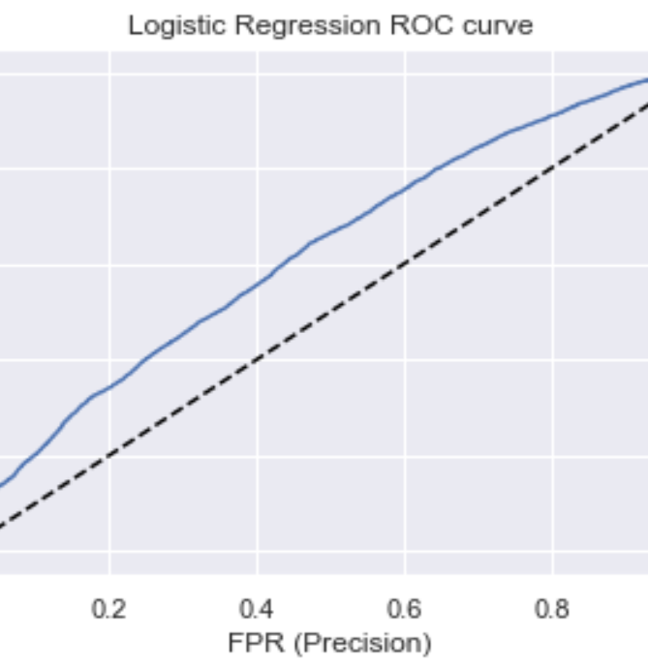
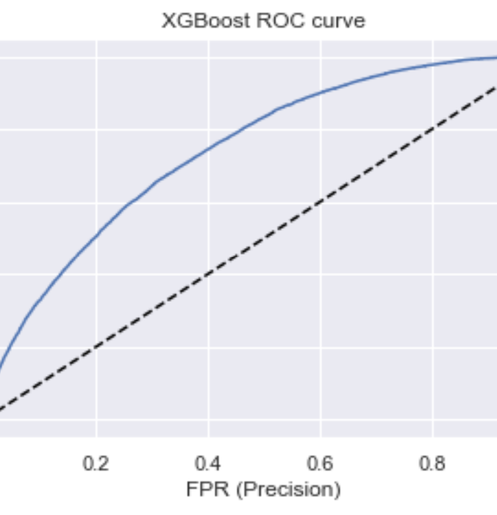
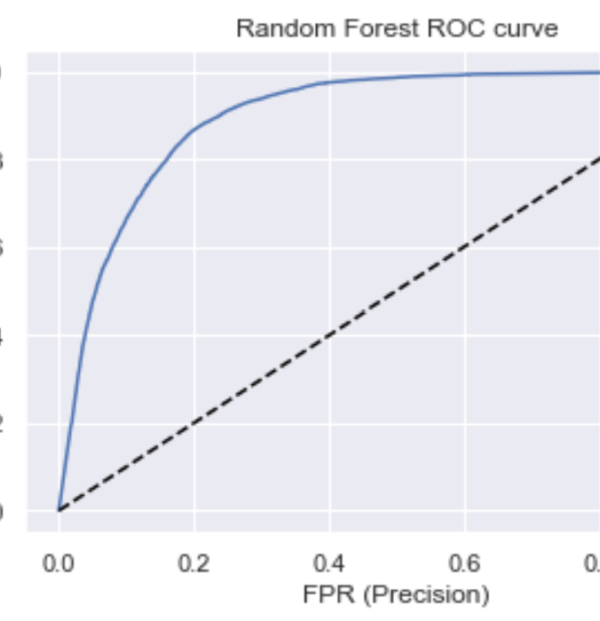
Higher AUC - Better performance
Random Forest has the best performance

Slide 4
Model Comparison
In Random Forest
Accuracy - 83% of the Predictions are accurate including add click or no click
Precision – Out of all positive clicks identified, 79% are right
Recall - 90% of True add clicks are identified correctly
Model | Accuracy | Recall | Precision | F1 Score | ROC AUC
Logistic regression | 0.575594 | 0.515287 | 0.590081 | 0.550153 | 0.577151
Randomforest | 0.831796 | 0.904785 | 0.791210 | 0.844195 | 0.839063
XGBClassifier | 0.673749 | 0.697079 | 0.669019 | 0.682761 | 0.673995

